Slide 1

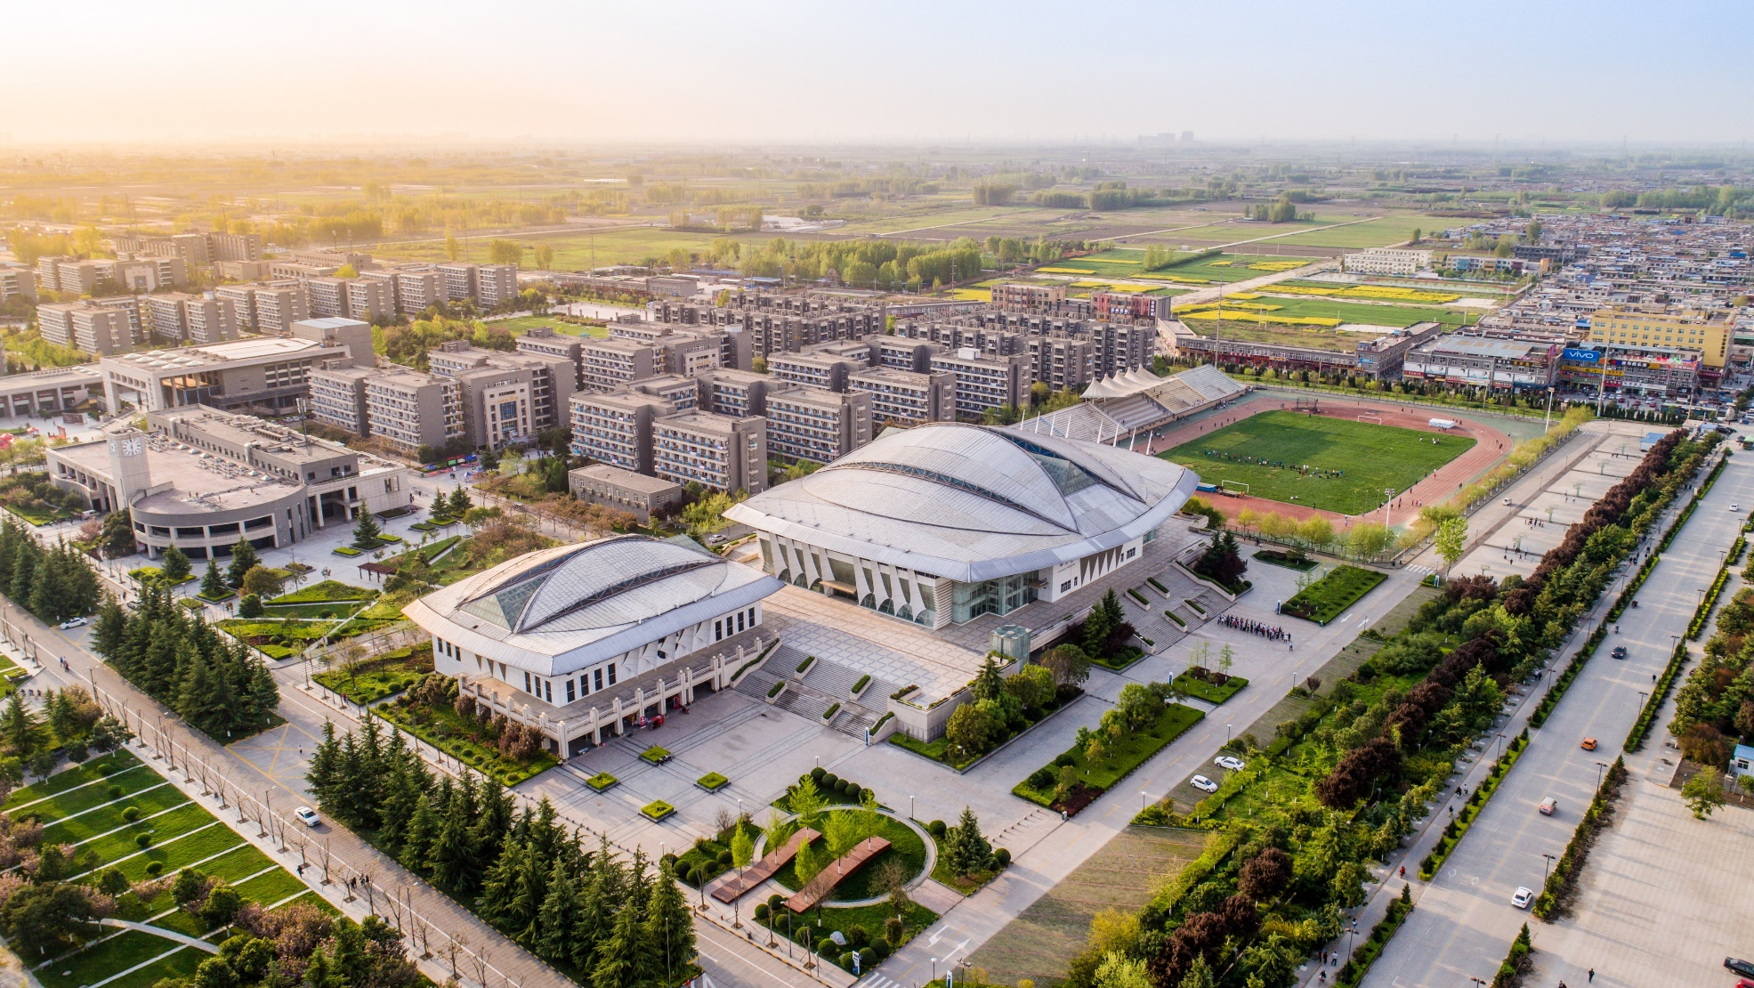
Project Management
From Theory to Practice
School of Management Zhi Chen
12/12/2020
Northwestern Polytechnical University

Slide 2
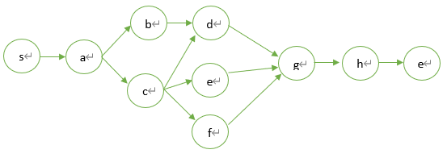
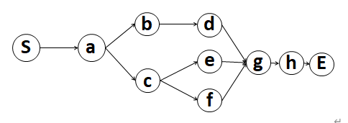
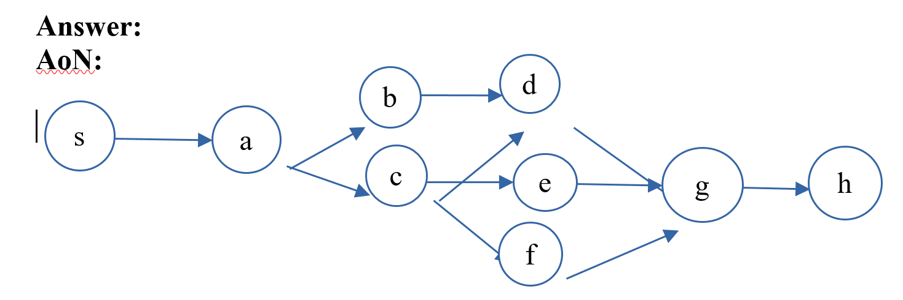
HW1
Please give the AoN and AoA networks of the following project.
Activity | Immediate successors
a | b,c
b | d
c | d,e,f
d | g
e | g
f | g
g | h
h
The project network require only 1 start and 1 end node. As the project has only 1 start and 1 end activity, so we do not need the dummy start and dummy end activity.
After finish the network, you should check the precedence relationship between every pair activities. This network lack the relationship between c and d.
Every arc should be connected to node.

Slide 3
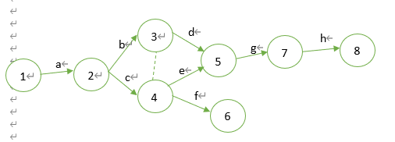
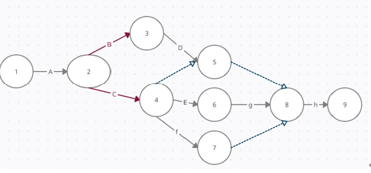
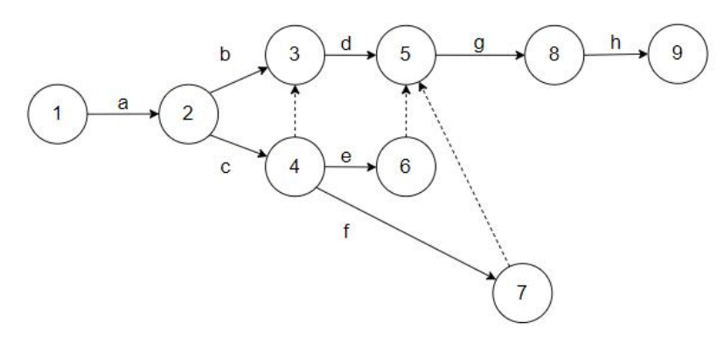
HW1
Please give the AoN and AoA networks of the following project.
Activity | Immediate successors
a | b,c
b | d
c | d,e,f
d | g
e | g
f | g
g | h
h
The project network require only 1 start and 1 end node. This network has 2 end node (node 6 and node 8). No connecting lines without arrow.
Here activity d and activity f do not have successor g. activity c does not have successor d.
This solution is right, but we can delete node 7 and add node 4 and node 5 as activity 7. Less node and dummy activity is preferable.

Slide 4
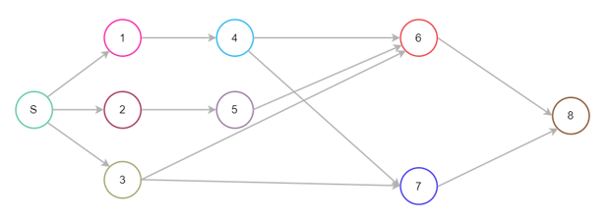
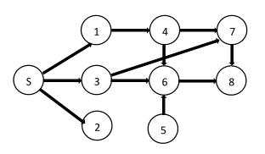
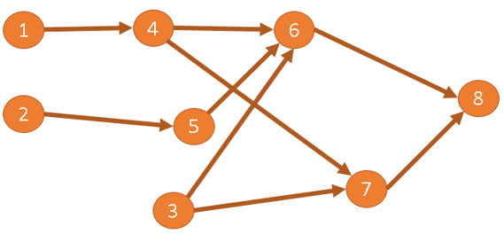
HW1
please give the AoN and AoA network of the following project.
Activity | Immediate predecessors
1
2
3
4 | 1
5 | 2
6 | 3,4,5
7 | 3,4
8 | 6,7
This solution is right, but we prefer no crossing arrow line .
Activity 5 does not have predecessor 2.
More than 1 start activity in this network.

Slide 5
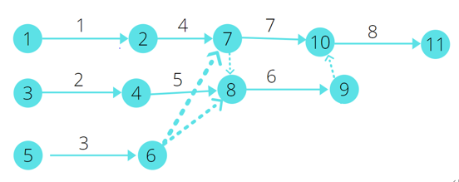
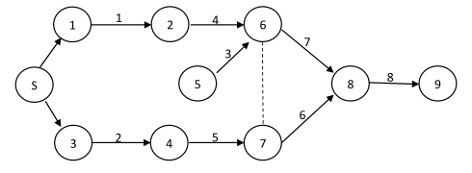
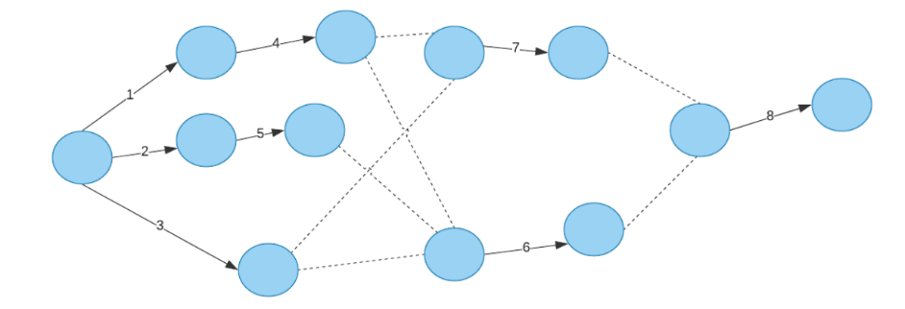
HW1
please give the AoN and AoA network of the following project.
Activity | Immediate predecessors
1
2
3
4 | 1
5 | 2
6 | 3,4,5
7 | 3,4
8 | 6,7
More than 1 start node in this network. You can delete node 9 add node 8 and 10 directly as activity 6.
More than 1 start node in this network. The dash line has no arrow. The arrows start from node s have no activity label.
No labels on the nodes, and too many unnecessary dummy antivities.

Slide 6
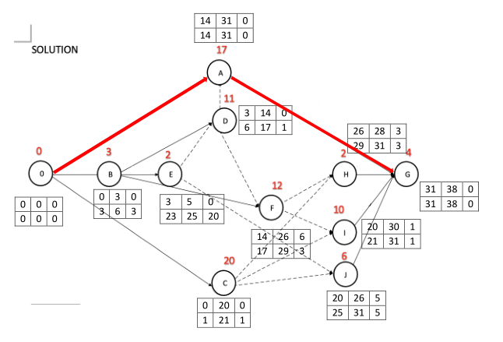
HW1
3、please calculate the ES, EF, LS, LF, FF, TF time of every activity in the project.(the letter and number on the arc are activity and it’s duration)
 | ES | EF | LS | LF | FF | TF
A | 0 | 17 | 6 | 23 | 0 | 6
B | 0 | 3 | 5 | 8 | 0 | 5
C | 0 | 20 | 0 | 20 | 0 | 0
D | 3 | 14 | 9 | 20 | 0 | 6
E | 3 | 5 | 18 | 20 | 0 | 15
F | 3 | 15 | 8 | 20 | 0 | 5
G | 17 | 24 | 23 | 30 | 6 | 6
H | 20 | 22 | 28 | 30 | 8 | 8
I | 20 | 30 | 20 | 30 | 0 | 0
J | 20 | 26 | 24 | 30 | 4 | 4
Red activities are critical activities.
Please note that this is a AOA network, not a AON network, the right graph is totally wrong. You should first calculate the early time and late time for every node, and then calculate the ES, EF, LS, LF, FF, TF.

Slide 7
HW1
4、please calculate the ES, EF, LS, LF, FF, TF time of every activity in the project.(the number on the node is activity duration)
 | ES | EF | LS | LF | FF | TF
1 | 0 | 0 | 0 | 0 | 0 | 0
2 | 0 | 4 | 0 | 4 | 0 | 0
3 | 0 | 7 | 11 | 18 | 0 | 11
4 | 0 | 8 | 5 | 13 | 5 | 5
5 | 4 | 13 | 4 | 13 | 0 | 0
6 | 7 | 13 | 18 | 24 | 0 | 11
7 | 13 | 15 | 24 | 26 | 11 | 11
8 | 13 | 26 | 13 | 26 | 0 | 0
9 | 26 | 37 | 26 | 37 | 0 | 0
Red activities are critical activities.

Slide 8
HW2
1、Using the program evaluation and review technique to calculate the probability the project can be finished before 70 days.
activity | Optimistic time | Realistic time | Pessimistic time
1 | 4 | 5 | 8
2 | 4 | 6 | 9
3 | 6 | 9 | 13
4 | 10 | 12 | 18
5 | 5 | 7 | 9
6 | 11 | 12 | 14
7 | 9 | 10 | 15
8 | 4 | 6 | 8
9 | 7 | 10 | 13
10 | 8 | 9 | 14
11 | 4 | 7 | 8
12 | 6 | 8 | 12
13 | 6 | 7 | 10
14 | 3 | 5 | 9
Step1, calculate the expected time of each activity.
Step2, determine the critical activities.
Step3, calculate the expected duration of the project, and variance of the project duration.
Step4, calculate the probability.

Slide 9
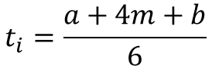
HW2
Step1, calculate the expected time of each activity.
activity | Optimistic time | Realistic time | Pessimistic time
1 | 4 | 5 | 8
2 | 4 | 6 | 9
3 | 6 | 9 | 13
4 | 10 | 12 | 18
5 | 5 | 7 | 9
6 | 11 | 12 | 14
7 | 9 | 10 | 15
8 | 4 | 6 | 8
9 | 7 | 10 | 13
10 | 8 | 9 | 14
11 | 4 | 7 | 8
12 | 6 | 8 | 12
13 | 6 | 7 | 10
14 | 3 | 5 | 9
activity | expected time
1 | 32/6
2 | 37/6
3 | 55/6
4 | 76/6
5 | 42/6
6 | 73/6
7 | 64/6
8 | 36/6
9 | 60/6
10 | 58/6
11 | 40/6
12 | 50/6
13 | 44/6
14 | 32/6
expected time：
$$t_{i}=\frac{a+4m+b}{6}$$

Slide 10
HW2
Step2, determine the critical activities.
activity | Optimistic time | Realistic time | Pessimistic time
1 | 4 | 5 | 8
2 | 4 | 6 | 9
3 | 6 | 9 | 13
4 | 10 | 12 | 18
5 | 5 | 7 | 9
6 | 11 | 12 | 14
7 | 9 | 10 | 15
8 | 4 | 6 | 8
9 | 7 | 10 | 13
10 | 8 | 9 | 14
11 | 4 | 7 | 8
12 | 6 | 8 | 12
13 | 6 | 7 | 10
14 | 3 | 5 | 9
activity | ES | EF | LS | LF | TT
1 | 0 | 32/6 | 0 | 32/6 | 0
2 | 32/6 | 69/6 | 43/6 | 80/6 | 11/6
3 | 32/6 | 87/6 | 32/6 | 87/6 | 0
4 | 69/6 | 145/6 | 80/6 | 156/6 | 11/6
5 | 87/6 | 129/6 | 160/6 | 202/6 | 55/6
6 | 87/6 | 160/6 | 87/6 | 160/6 | 0
7 | 145/6 | 209/6 | 156/6 | 220/6 | 11/6
8 | 160/6 | 196/6 | 202/6 | 238/6 | 42/6
9 | 160/6 | 220/6 | 160/6 | 220/6 | 0
10 | 220/6 | 278/6 | 220/6 | 278/6 | 0
11 | 220/6 | 260/6 | 238/6 | 278/6 | 18/6
12 | 278/6 | 328/6 | 278/6 | 328/6 | 0
13 | 260/6 | 304/6 | 284/6 | 328/6 | 24/6
14 | 328/6 | 360/6 | 328/6 | 360/6 | 0
Red activities are critical activities.
Using the expected activity duration and critical path method determine the critical activities.

Slide 11
HW2
Step3, calculate the expected duration of the project, and variance of the project duration.
activity | Optimistic time | Realistic time | Pessimistic time
1 | 4 | 5 | 8
2 | 4 | 6 | 9
3 | 6 | 9 | 13
4 | 10 | 12 | 18
5 | 5 | 7 | 9
6 | 11 | 12 | 14
7 | 9 | 10 | 15
8 | 4 | 6 | 8
9 | 7 | 10 | 13
10 | 8 | 9 | 14
11 | 4 | 7 | 8
12 | 6 | 8 | 12
13 | 6 | 7 | 10
14 | 3 | 5 | 9
T_{E}=32/6+55/6+73/6+60/6+58/6+50/6+32/6=360/6=60
S²=(8-4)²/36+(13-6)²/36+(14-11)²/36+(13-7)²/36+(14-8)²/36+(12-6)²/36+(9-3)²/36=218/36
Expected project duration：$T_{E}=$sum of the expected durations of the critical activities.
Variance of the project duration ：$S^{2}=$sum of the variances of the activities along the critical path.

Slide 12
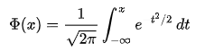
HW2
Step4, calculate the probability.
activity | Optimistic time | Realistic time | Pessimistic time
1 | 4 | 5 | 8
2 | 4 | 6 | 9
3 | 6 | 9 | 13
4 | 10 | 12 | 18
5 | 5 | 7 | 9
6 | 11 | 12 | 14
7 | 9 | 10 | 15
8 | 4 | 6 | 8
9 | 7 | 10 | 13
10 | 8 | 9 | 14
11 | 4 | 7 | 8
12 | 6 | 8 | 12
13 | 6 | 7 | 10
14 | 3 | 5 | 9
P=
=99.99758%
Here the function phi represents the cumulative distribution function (CDF) of the standard normal distribution.

Slide 13
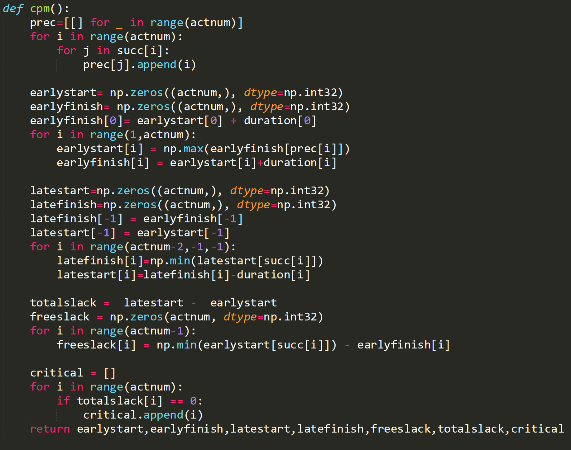
HW3
Using the python programming to calculate the following project activities’ early start time, early finish time, late start time, late finish time, total slack, free slack, and determine the critical activities.
Calculate the predecessors of each activity.
Initialize the ES, EF as 0.
Calculate the ES and EF time of each activity. As the first activity always starts from 0, you can calculate from second activity.
Let the LS and LF time of the last activity equals the EF(ES). And calculate the LS and LF time of each activity in the reverse order.
Calculate the free slack and total slack.
Determine the critical activities.

Slide 14
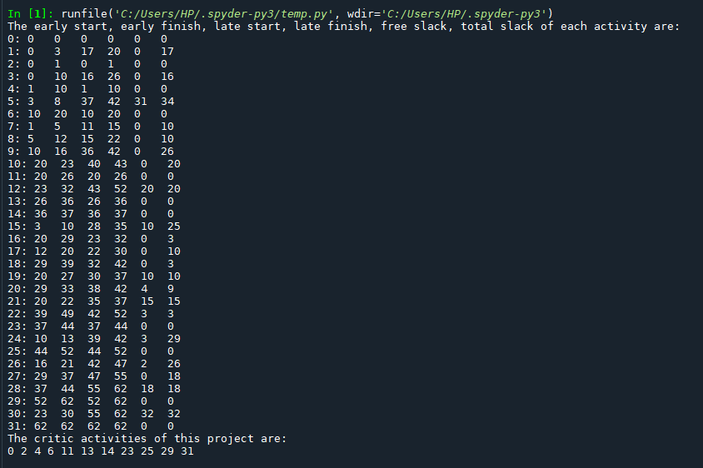
HW3
Using the python programming to calculate the following project activities’ early start time, early finish time, late start time, late finish time, total slack, free slack, and determine the critical activities.
Here is the print results.

Slide 15
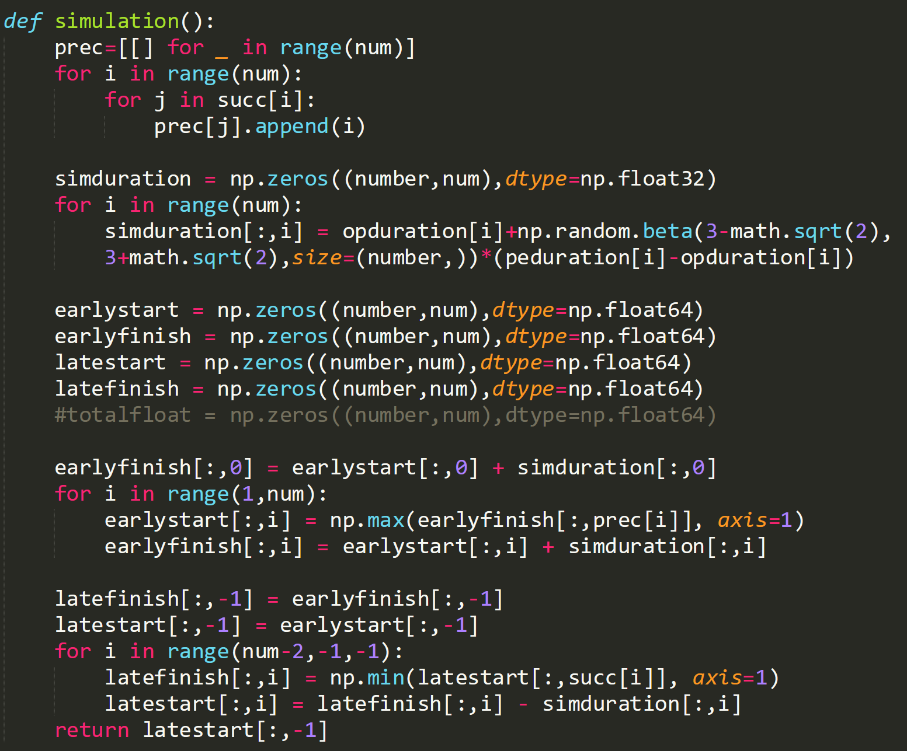
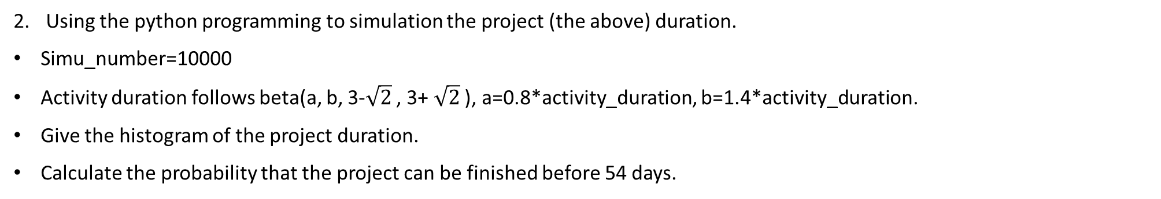
HW3
Using the python programming to simulation the project (the above) duration.
Simu_number=10000
Activity duration follows beta(a, b, 3-$\sqrt{2}$ , 3+ $\sqrt{2}$ ), a=0.8*activity_duration, b=1.4*activity_duration.
Give the histogram of the project duration.
Calculate the probability that the project can be finished before 54 days.
Calculate the predecessors of each activity.
Simulate the activity duration using beta distribution.
Initialize the ES, EF , LS, LF as 0.
Calculate the ES, EF , LS, LF, and return the project duration of every simulation.

Slide 16
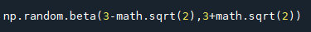
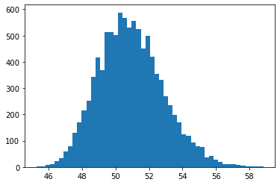
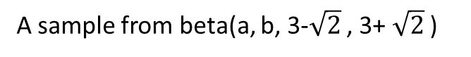
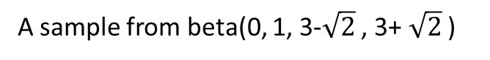
HW3
How to get the required beta distribution data?
A sample from beta(0, 1, 3-$\sqrt{2}$ , 3+ $\sqrt{2}$ )
A sample from beta(a, b, 3-$\sqrt{2}$ , 3+ $\sqrt{2}$ )
How to get the probability?
You have 10,000 sampled project duration, in which 7,000 have a project duration less than 54days, so the probability is 7000/10000=0.7. Of course, this is a simulation result, not analysis result.
Probability=0.934 (in my simulation)
Here we do not need to apply the normal distribution, because the sampled project duration may not fit the normal distribution.

Slide 17
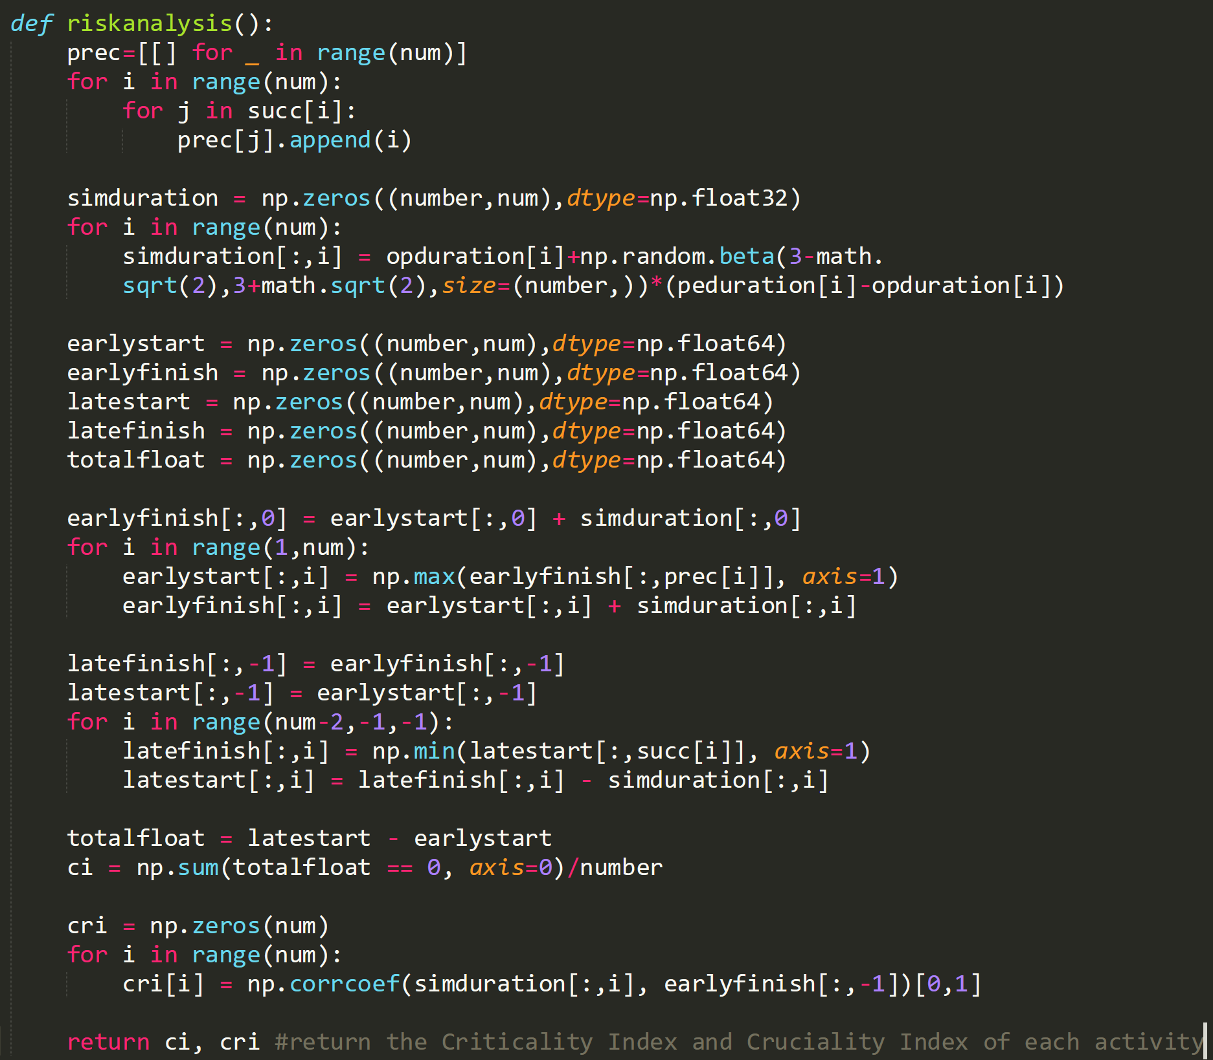
HW3
Calculate the Criticality Index and Cruciality Index(Using the Pearson’s product moment correlation) of each activity.
Same with project simulation.
Calculate the totalfloat of each activity and calculate the CI index of each activity.
Calculate the CRI index of each.

Slide 18


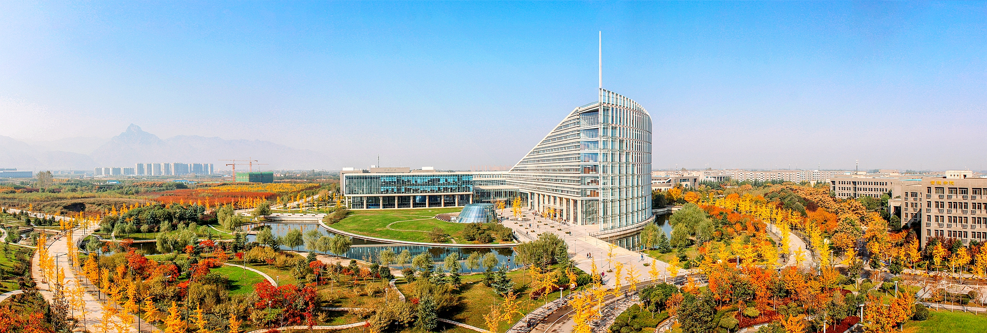
Northwestern Polytechnical University
基础扎实
工作踏实
作风朴实
开拓创新

